Slide 1
Final Project Arduino Alarm
Aaron Nelson

Slide 2



The Problem

Slide 3
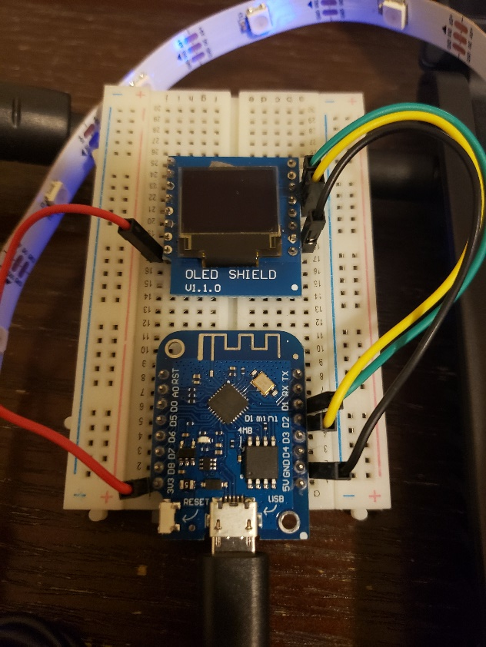
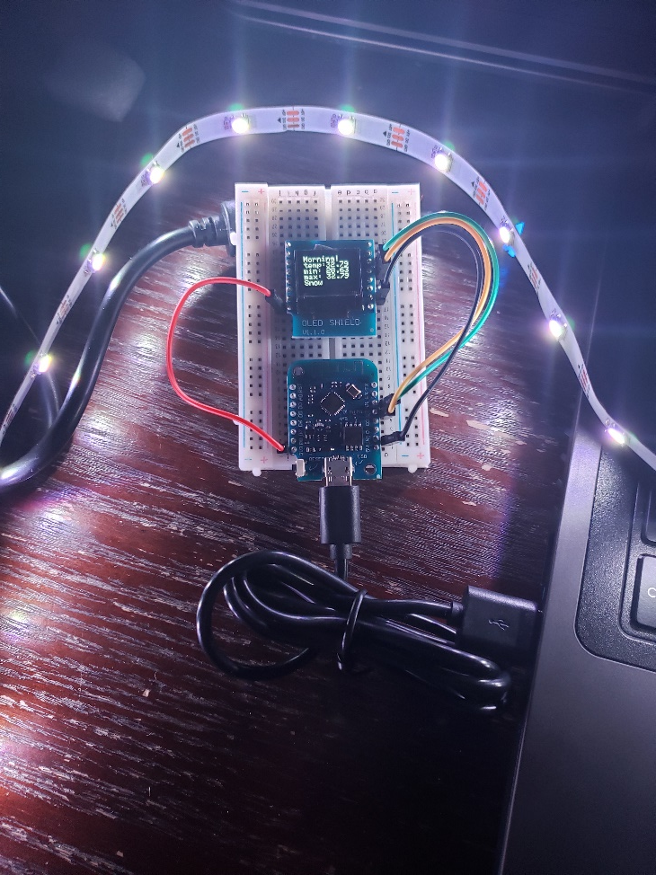
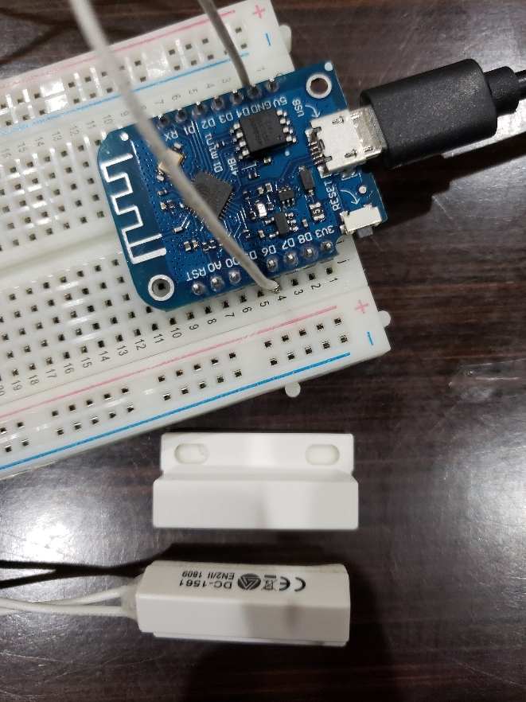
The Solution

Slide 4
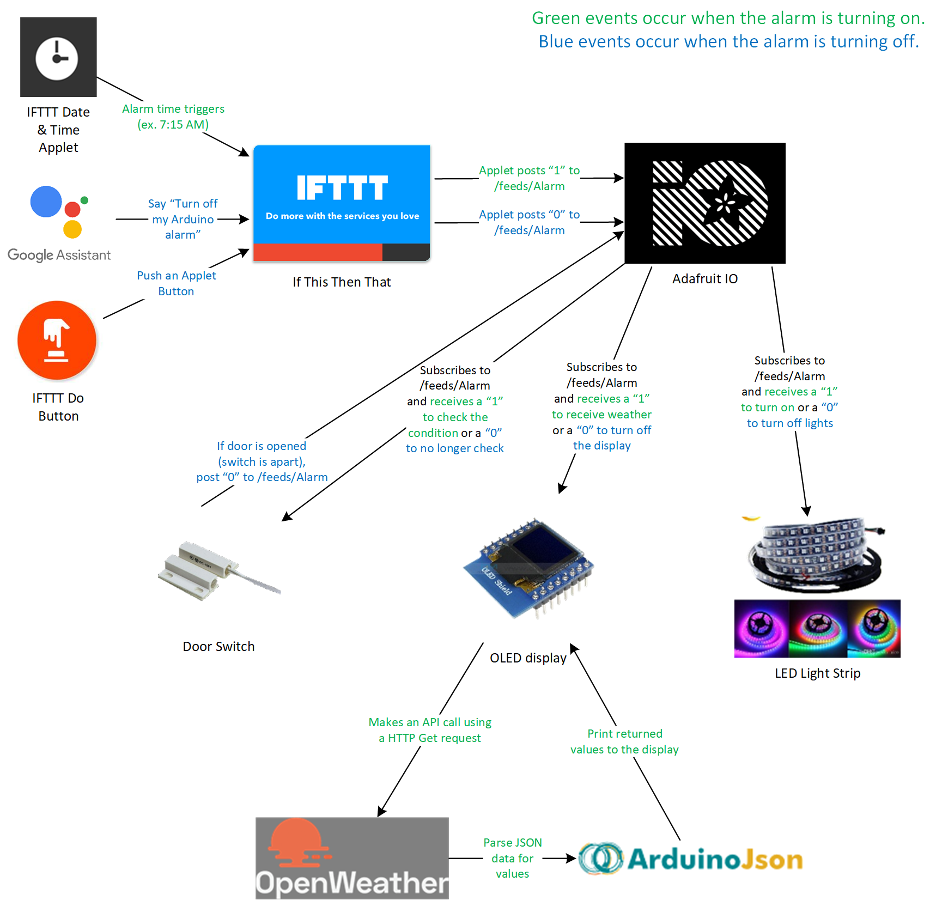
Device Interaction

Slide 5
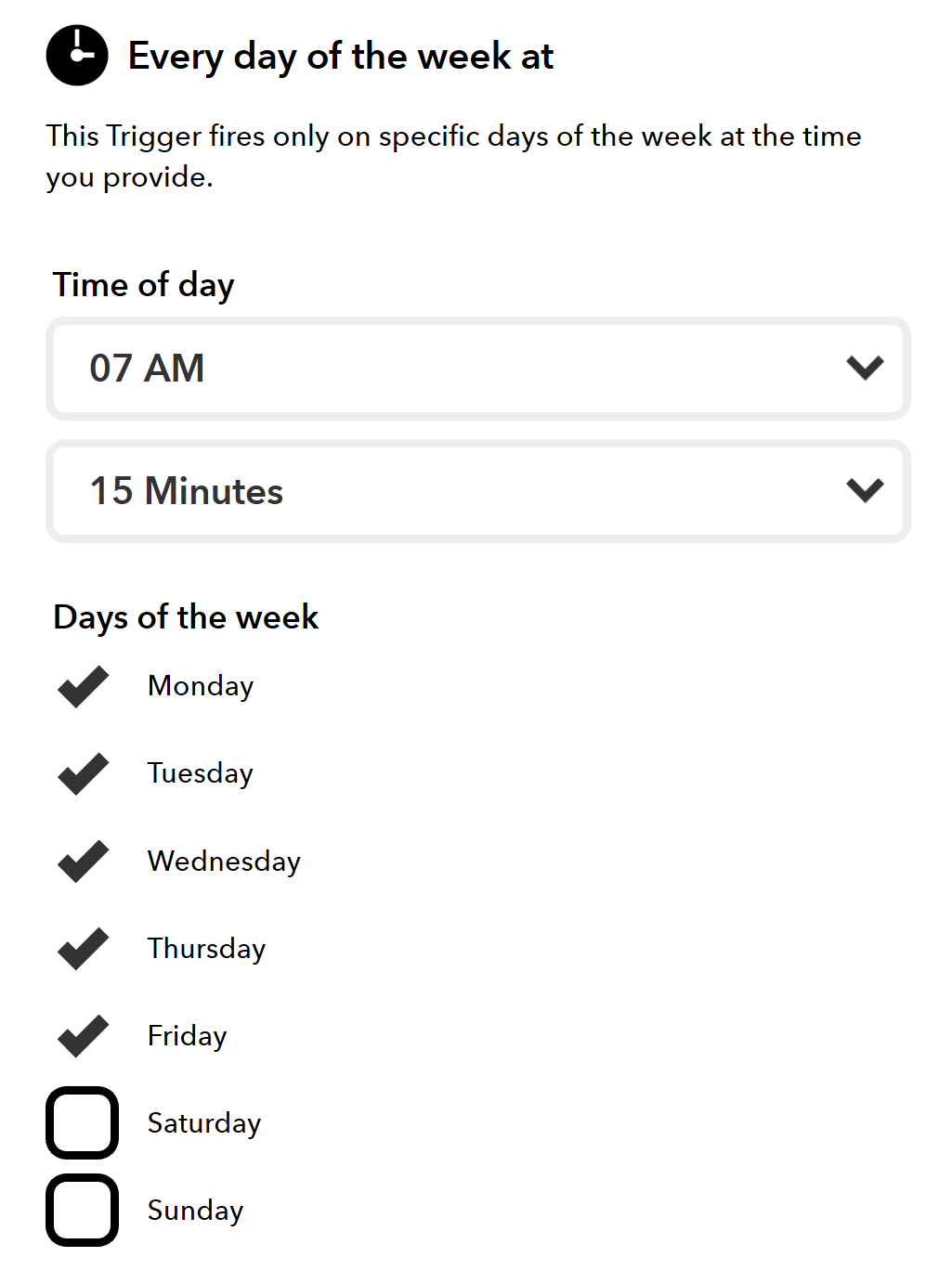
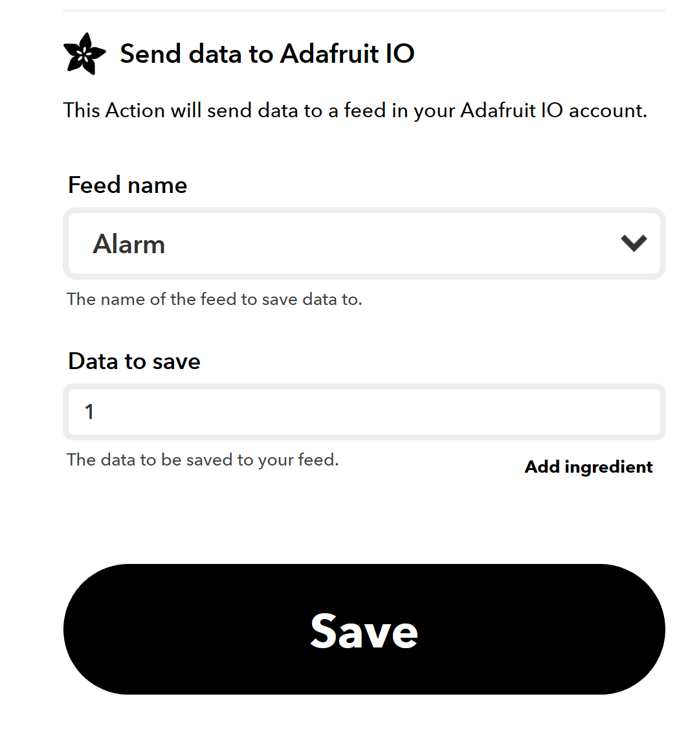
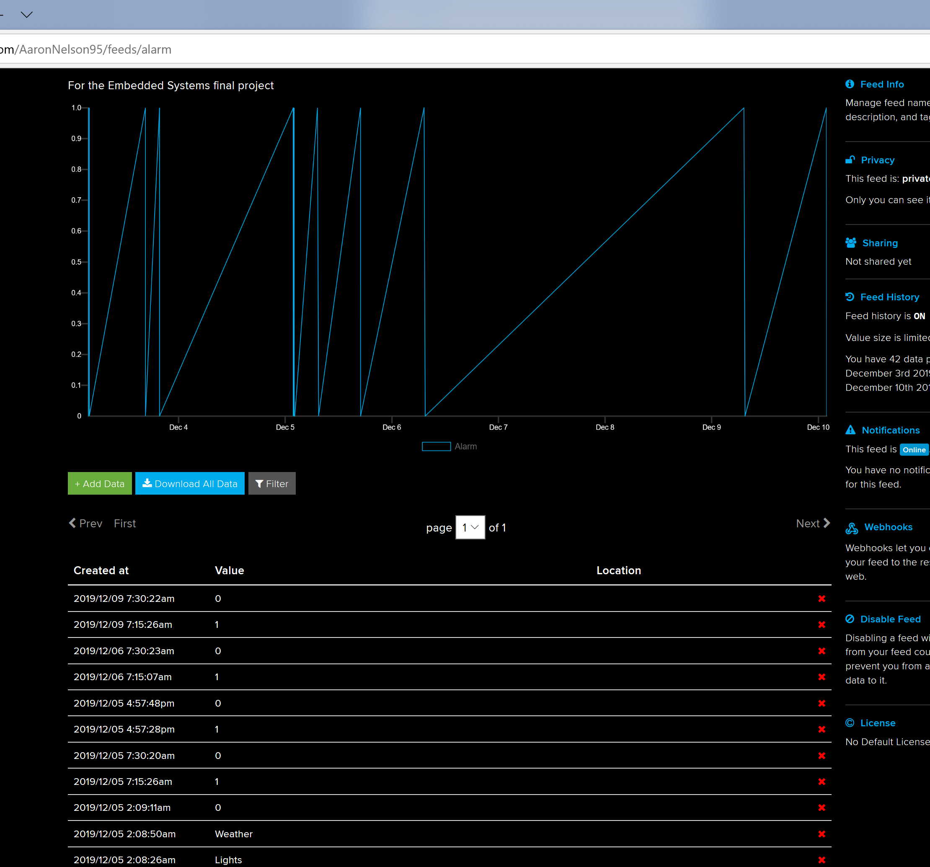
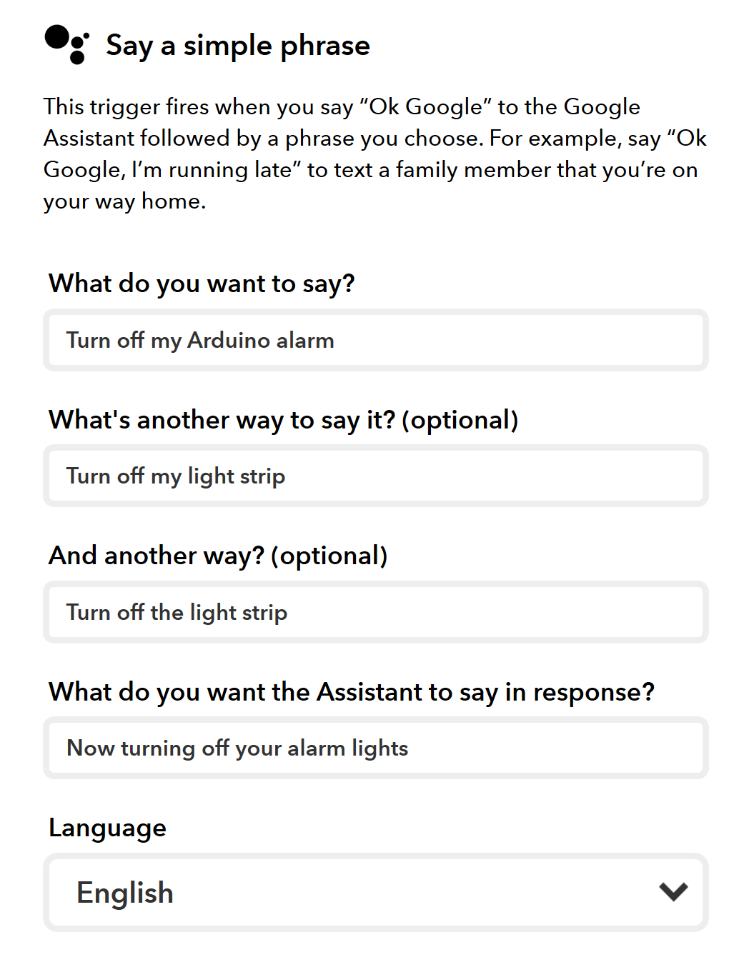
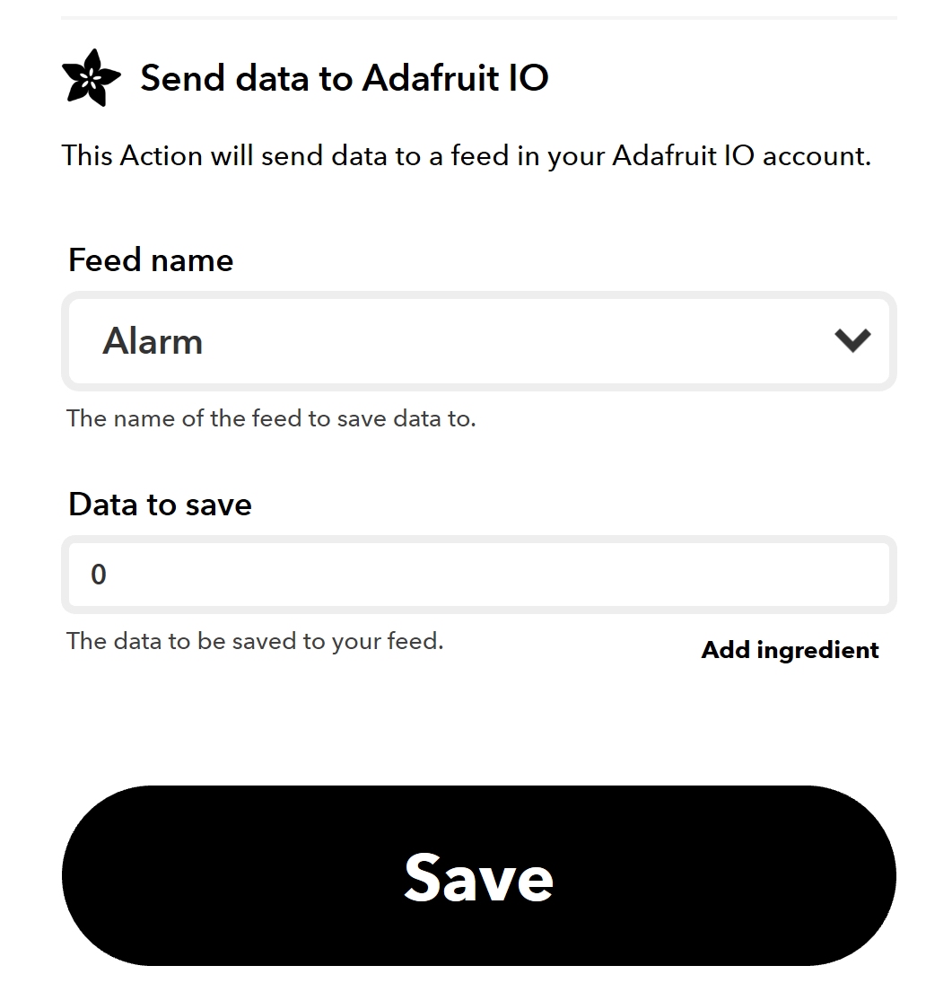
IFTTT and Adafruit IO

Slide 6
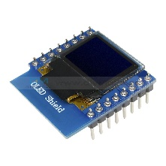
New Technologies Learned
A WS2812B LED Light Strip
A SSD1306 Wemos OLED Shield (screen size 64x48)
ArduinoJson Library
OpenWeather API

Slide 7

LED Light Strip
// How many leds in your strip? #define NUM_LEDS 15 // actually has 150, use up to 30 #define DATA_PIN D6 CRGB leds[NUM_LEDS]; FastLED.addLeds<WS2812B, DATA_PIN, RGB>(leds, NUM_LEDS);
for (int i=0; i < NUM_LEDS; i++) { leds[i] = CRGB::White; FastLED.setBrightness( 50 ); FastLED.show(); // delay(50); // turn the lights on one by one
}
Works with the FastLED library
Define your strip and initialize it
Access lights with an array
FastLED.show() to apply changes

Slide 8
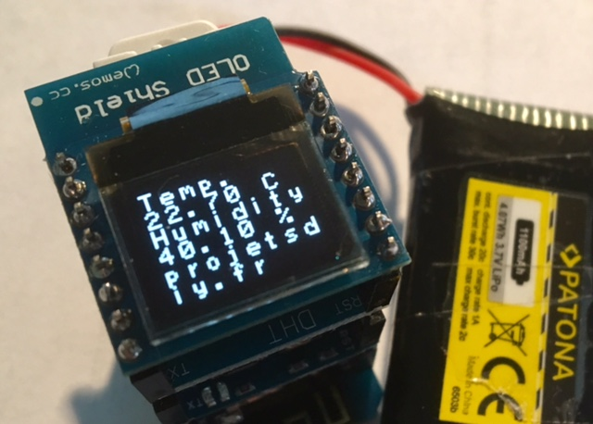
OLED Display
#define OLED_RESET -1 // GPIO0 Adafruit_SSD1306 display(OLED_RESET); #define XPOS 0 #define YPOS 1 #define LOGO16_GLCD_HEIGHT 16 #define LOGO16_GLCD_WIDTH 16 #if (SSD1306_LCDHEIGHT != 48) #error("Height incorrect, please fix Adafruit_SSD1306.h!"); #endif
display.begin(SSD1306_SWITCHCAPVCC, 0x3C); // initialize the OLED display with the I2C addr 0x3C (for the 64x48)
Uses the Wire (to communicate with I2C), Adafruit_GFX, and Adafruit_SSD1306 Libaries
Setup the screen with height and width (example code)
display.begin() to initialize
Write data to the strip
display.display() to commit changes
display.clearDisplay(); // Show nothing on the OLED screen display.setCursor(0,0); // Reset the text cursor to the top left display.println("Morning!"); // Write out the temperature messages display.println("temp:" + temperature); display.display(); // Commit this text to the board

Slide 9
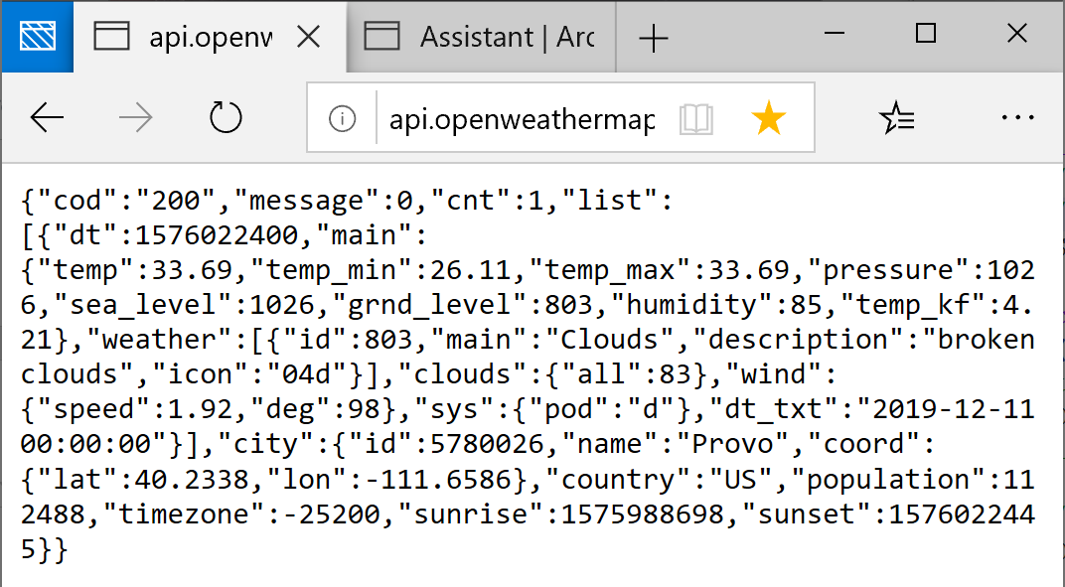
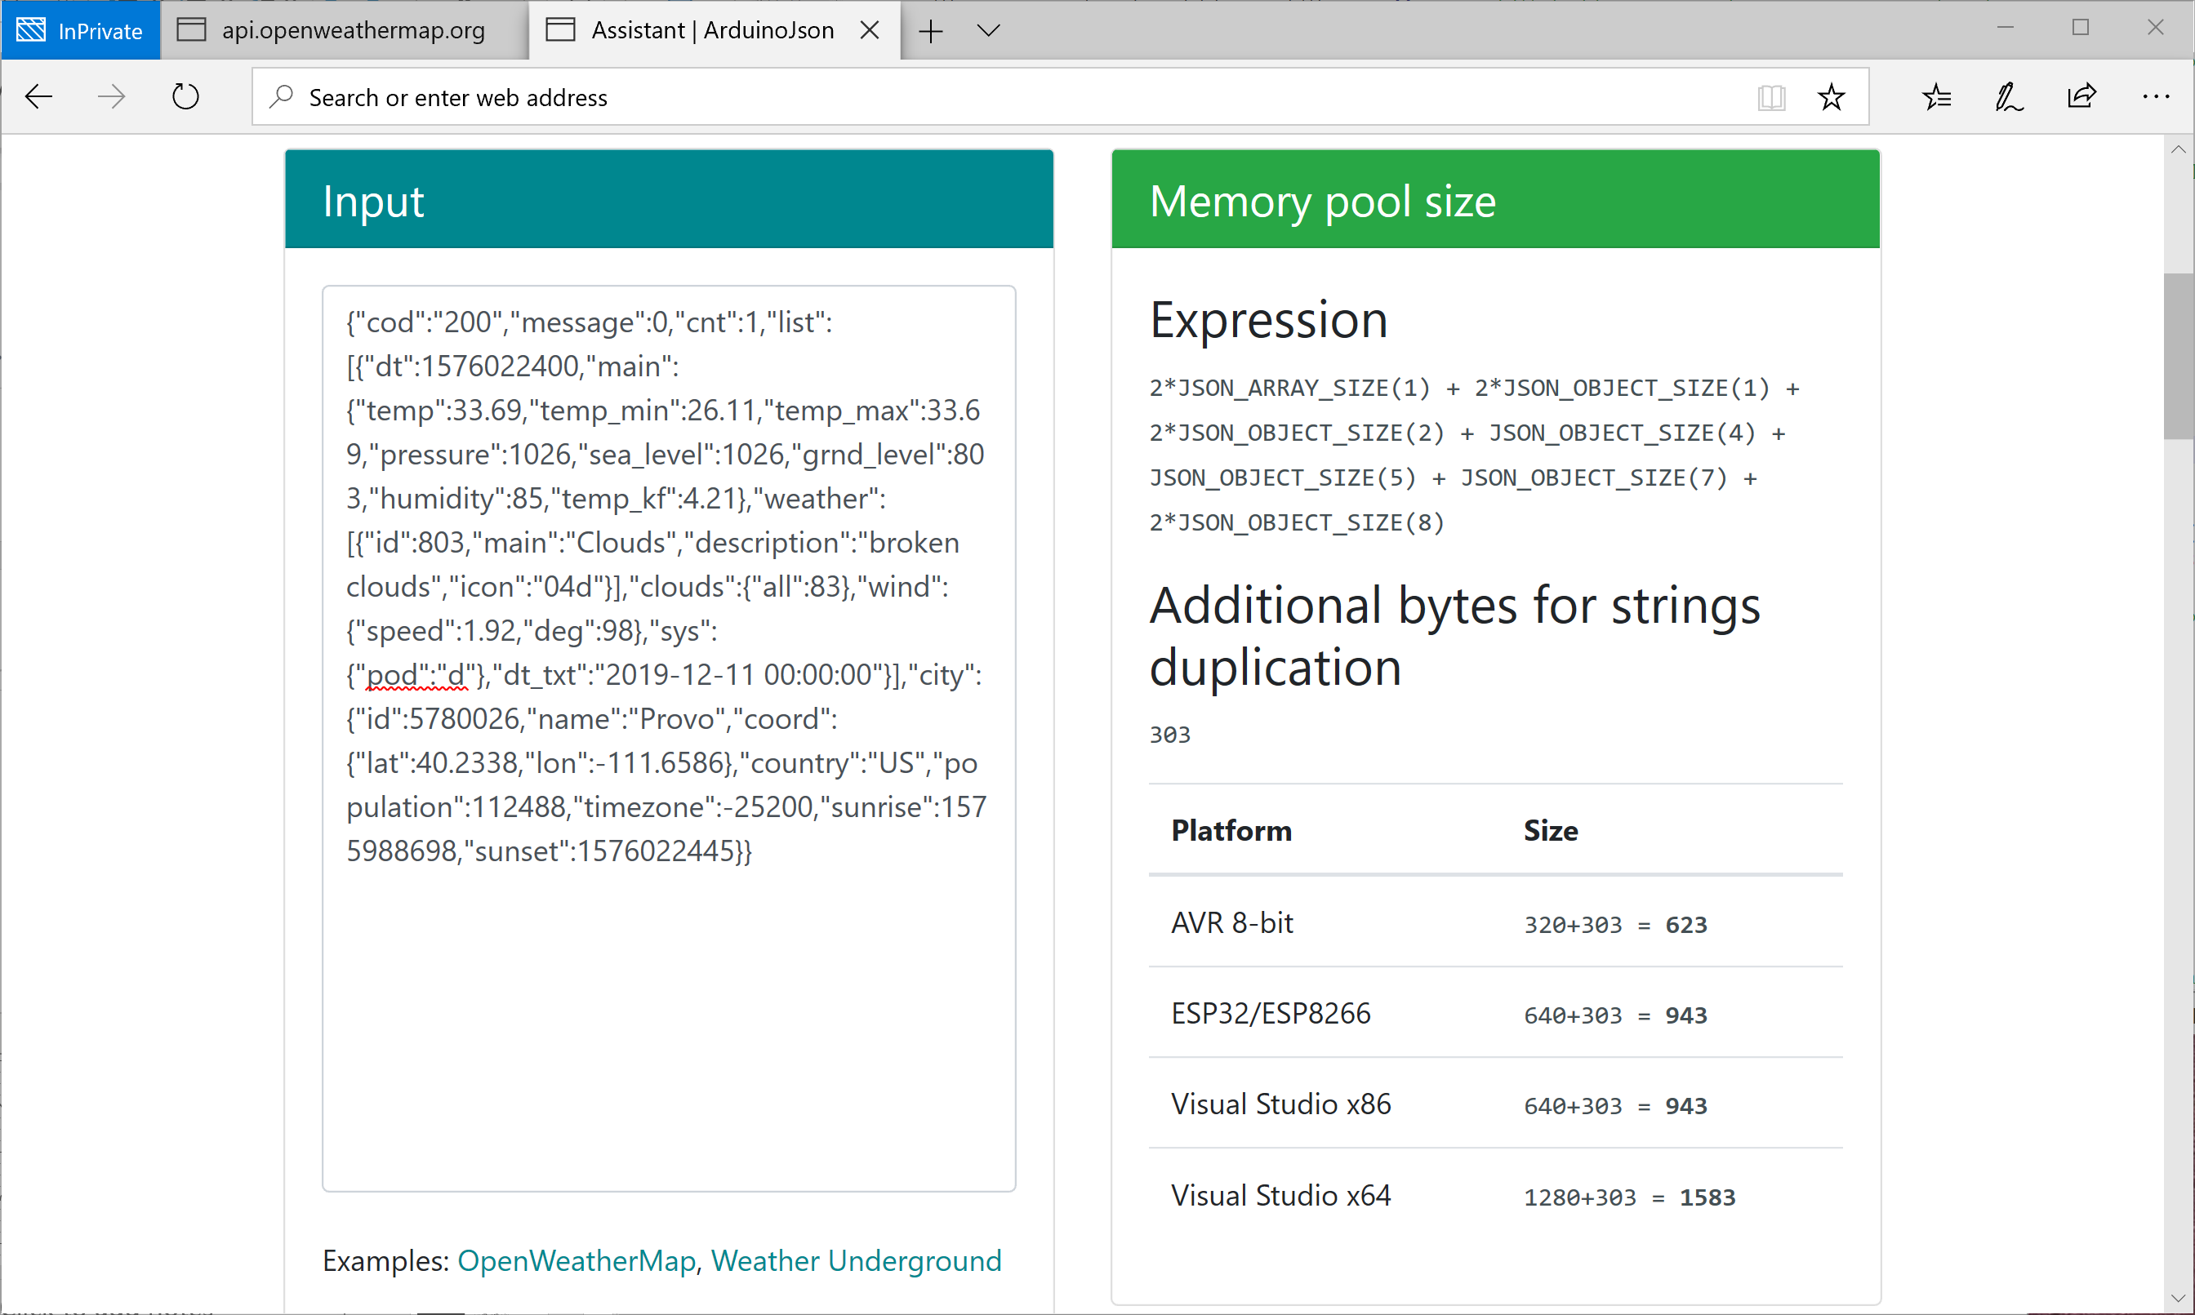
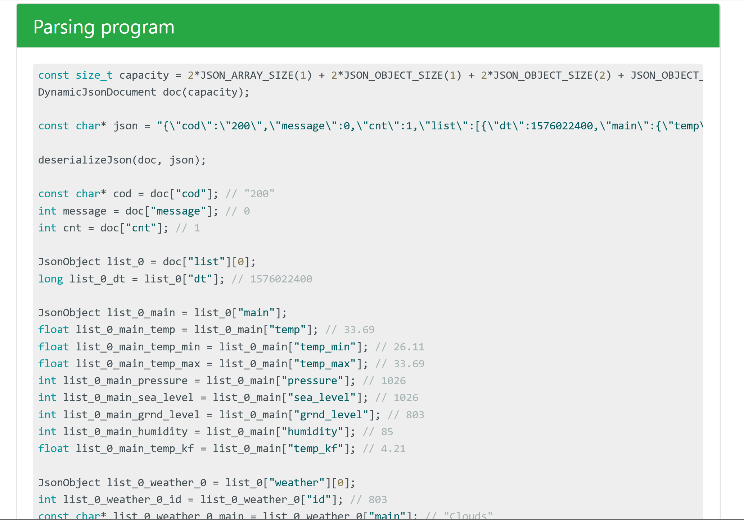
API and JSON
HTTP Get request to store JSON information from an API
ArduinoJson library to parse information
Need to allocate memory for your JSON file in the heap
Need to know size of document
https://arduinojson.org/v6/assistant/

Slide 10
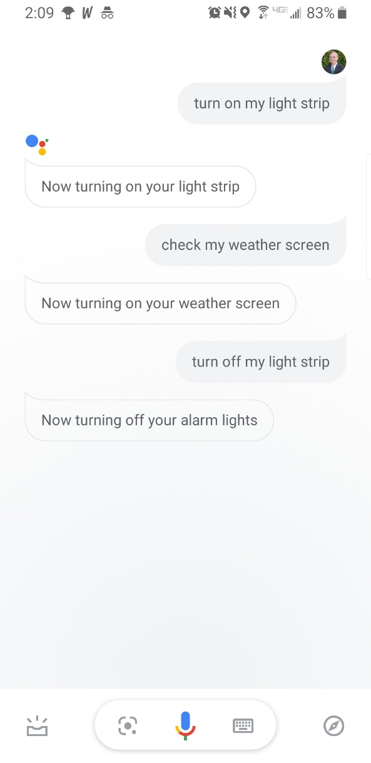
Demo

Slide 11
Problems Encountered
Light Strip needed too much power
Solved by using only a few LEDs (15-30)
Turned down brightness on them
Challenge to make an HTTPS request
Attempted to manually add certificate, use different libraries
Ultimately found a different API that works across HTTP

Slide 12
Future Plans
Work with an HTTPS get request
To use a weather API I prefer
Fully utilize the LED Light Strip
Provide an external source to provide power
Explore more with the FastLED Library
Build and experiment with additional devices to turn off the alarm
Using echo sensor to detect movement

Slide 13
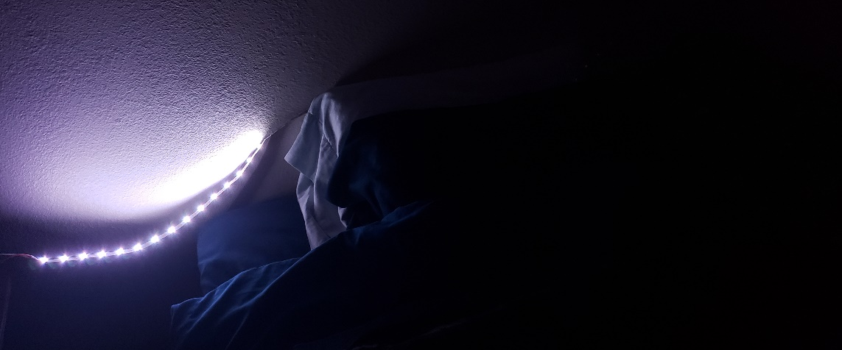
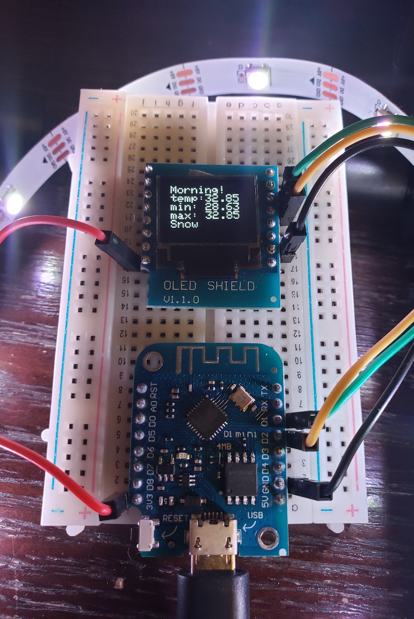
Conclusion

